Slide 1
Autonomous Mobile Vehicle
Group 12
Devon Wilkerson - CpE
Sergio Gonzalez - CpE
Kris Choudhury - CpE
Benjamin Goerdt - EE

Slide 2
Introduction
Our project is an ‘Level 4’ autonomous vehicle capable of assisting researching with data collection across various types of terrain. The vehicle will utilize self-navigation and be able to avoid different hazards as well as monitor various data points and display it on a UI.
• Level 0 - No automated control
• Level 1 - Some driver assistance; steering or throttle control
• Level 2 - Some driver assistance; steering and throttle control
• Level 3 - Automation; operator controls vehicle when there is a fault
• Level 4 - Automation in a regional area during set times or conditions;
computer controls faults
• Level 5 - Automation anywhere and during all times; computer controls
faults

Slide 3
Motivation
The motivation behind this project is to explore current technologies and to build and design a prototype for an autonomous vehicle that can survey and measure information from many different environments, as well as promote safety standards to current vehicles.
Exploration and safety are key factors that motivate our design, as we hope for this vehicle to one day be used on an extraterrestrial environment and discover and gather a wide variety of information.

Slide 4
Goals and Objectives
To design a vehicle capable of semi-autonomous driving and navigation
To have a feature rich web portal for statistics and control
To have an abundance of sensors on it to gather data about the surrounding environment
These sensors include: temperature sensors, humidity sensors, oxygen sensors, carbon dioxide sensors, ultraviolet sensors, particulate matter sensors, volatile organic compound sensors, ozone sensors, light sensors, ultrasonic (proximity) sensors, and multiple cameras.
To have this data aid in the study of the condition of the surrounding environment, and also give us insight to the habitability of the areas the vehicle traversed.

Slide 5
Specifications and Requirements - Old and New
Run Time | Must run a minimum of 3 hours. | Must run a minimum of 1 hour.
Charge Time | Must charge in a maximum of 8 hours. | Must charge in a maximum of 6 hours.
Manual Driving Speed | Must be able to maintain a manual driving speed of 32km/h. | Must be able to maintain a manual driving speed of 8km/h
Autonomous Driving Speed | Must be able to maintain an autonomous driving speed of 8km/h. | Must be able to maintain an autonomous driving speed of 5km/h
GPS Display | Must display correct GPS coordinates within 2m. | Must display correct GPS coordinates within 2m.
Wifi/GSM Connectivity | Must be Wifi/GSM connected at 5Mb/s for live data transmission. | Must be Wifi/GSM connected at 5Mb/s for live data transmission.
Planning/Routing Capabilities | Must be able to plan and execute routing within 10s. | Must be able to plan and execute routing within 10s.
Quick GUI Feedback | Screen must give feedback within 100ms. | Screen must give feedback within 100ms.
Occupant Weight Limit | 2 seats for occupants with a 175lb limit each. | 1 seats for occupant with a 50lb limit
Maximum Weight Limit | Must be able to hold a maximum of400lbs | Must be able to hold a maximum of 60 pounds
Object Detection | Must detect external objects within 1000ms at 10m. | Must detect external objects within 1000ms at 10m
Notes:
Talk about original specs and why we changed them to fit the smaller vehicle. (Pedestrian safety, passenger safety, etc)

Slide 6
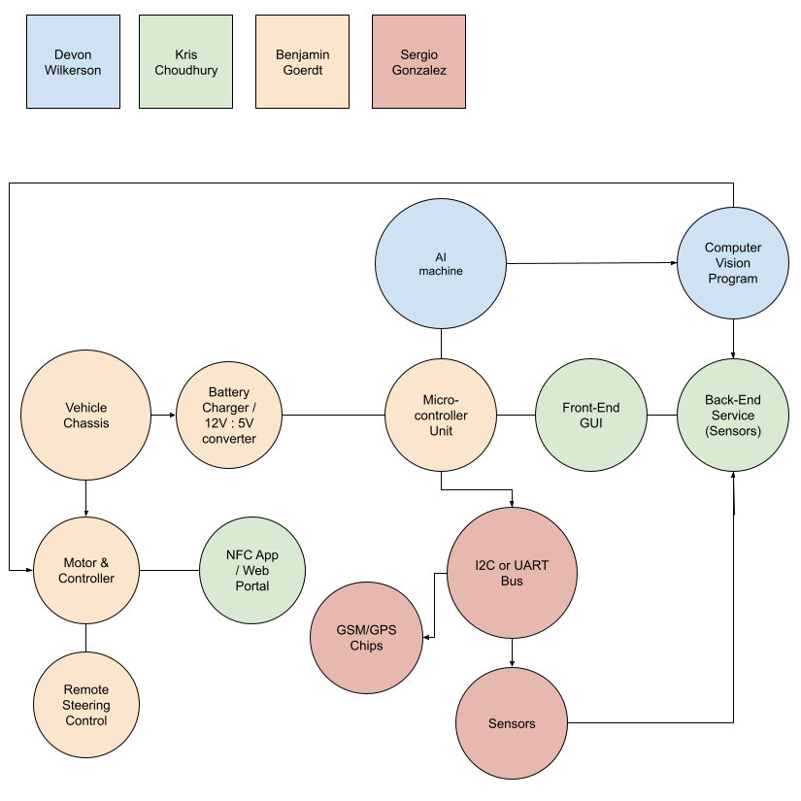
Design
Notes:
Talk about why we designed our vehicle this way

Slide 7
Bill of materials
Manufacturer | Part No. | Description | Quantity | Price | Quantity on Hand
NVIDIA | 945-13541-0000-000 | Jetson Nano System on Module - SOM Development Kit 4GB RAM Linux | 1 | 99.00 | 5
CanaKit | PI4-4GB-STR32F-C4-BLK | Raspberry Pi 4 - Starter Kit 4 GB Ram + 32 GB of Storage | 1 | 99.95 | 1000+
XYGStudy | SIM7600G-H 4G HAT | GSM Communication Module 4G 3G 2G for Raspberry Pi | 1 | 86.99 | 10
Arduino | A000066 | Arduino Uno Rev 3 based on ATMEGA328p | 1 | 23.00 | 1000+
Seeed Studio | 109020022 | Grove Air530 GPS Module | 1 | 9.88 | 126
Raspberry Pi | LCD-13733 | Raspberry Pi Foundation 7" Touchscreen LCD Display | 1 | 60.00 | 1000+
Seeed Studio | 113020006 | Grove NFC Sensor | 1 | 23.70 | 10+
Mighty Max | YTX12-BS10 | Spare Aftermarket Battery | 2 | 26.99 | 99+
Xinpuguang | 100W | Solar Panel & Charge Controller | 1 | 80 | 268
Traxxas | RC775 | High Power Drive Motor | 2 | 40.95 | 199+
Firgelli | LA35 | Linear Actuator | 1 | 110 | 499+
Best Choice Products | 12V-BL | Power Wheels Vehicle | 1 | 189.99 | 20+

Slide 8
Bill of materials - Continued
Manufacturer | Part No. | Description | Quantity | Price | Quantity on Hand
Adafruit | VEML7700 | Light Sensor | 1 | 4.95 | 761
Adafruit | VEML6070 | UV light sensor | 1 | 5.95 | 226
Adafruit | AM2320 | Temperature and Humidity Sensor | 1 | 3.95 | 304
DFRobot | SEN0322 | Oxygen Sensor | 1 | 53.90 | 68
Amphenol Advanced Sensor | T6703-5k | Carbon Dioxide Sensor | 1 | 37.99 | 95
Adafruit | PMSA003I | Particulate Matter Sensor | 1 | 37.99 | 6
Adafruit | SGP40 | Volatile Organic Compounds Sensor | 1 | 14.95 | N/A
Adafruit | HC-SR04 | Proximity Sensor | 4 | 7.94 | 11
Pololu | D24V50F5 | Voltage Regulator | 1 | 19.99 | 100+
Phoenix | 1729128 | Screw Terminal | 2 | 1.14 | 15,750
Infineon | IPU039N03LGXK-ND | N-Mos | 1 | 0.74 | 52
There are more items not included as we adapt to issues, such as an accelerometer and inertial measurement unit for localization. Our team is always learning more about the systems in the vehicle, and we’re buying parts as necessary.

Slide 9
Budget
Our goal was to contribute $500 each, for a total budget of $2,000.
Sensors | 395
Computing Devices | 140
PCB & misc components | 75
Chassis | 250
Battery/Solar | 150
Drive Upgrades | 190
Misc Prototyping | 300
Total | $1500

Slide 10
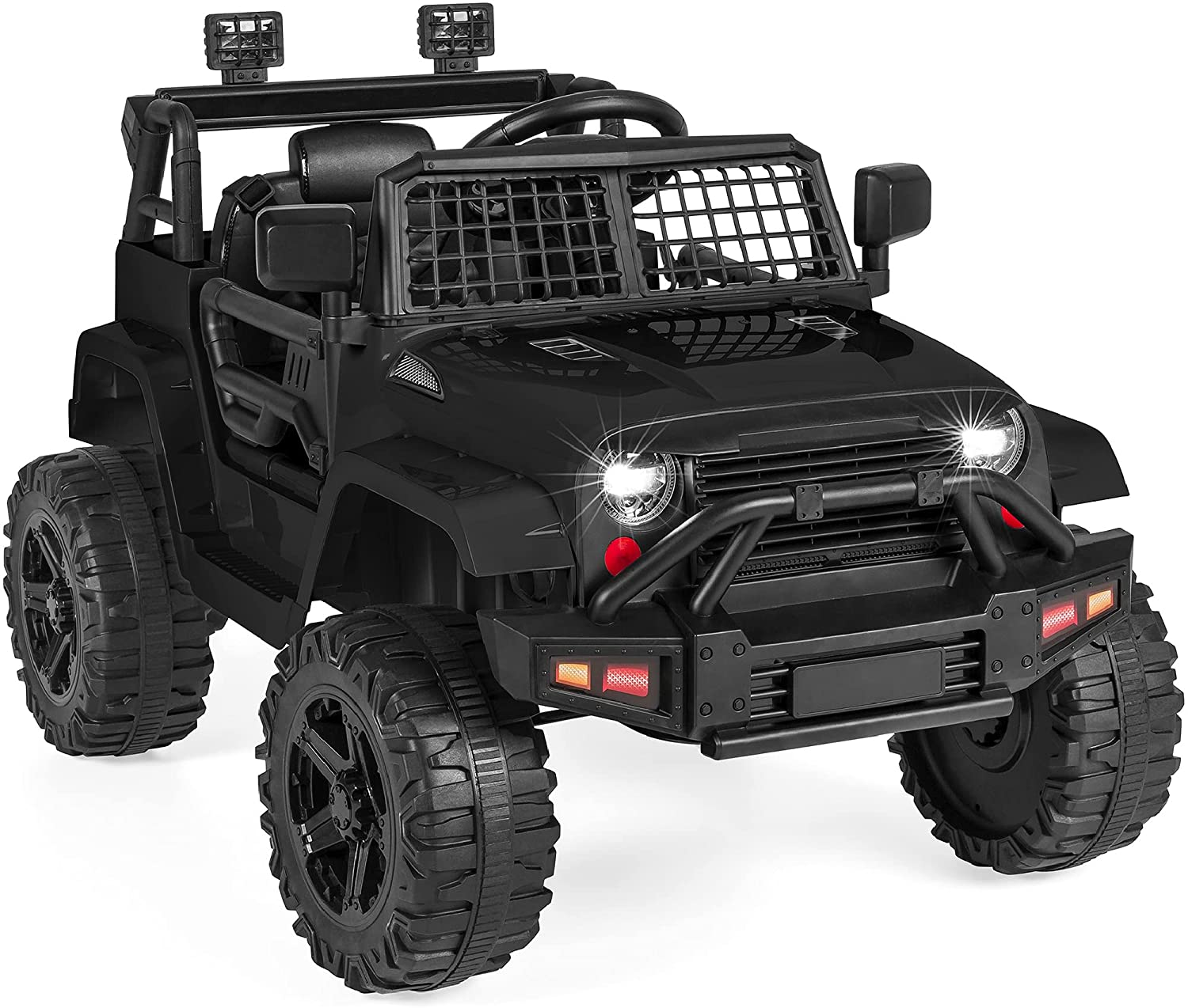
Vehicle (Power Wheels)
12V Battery operated power wheels
Includes a remote control
Electronic steering capability
Replaceable battery
Room for motor upgrade

Slide 11
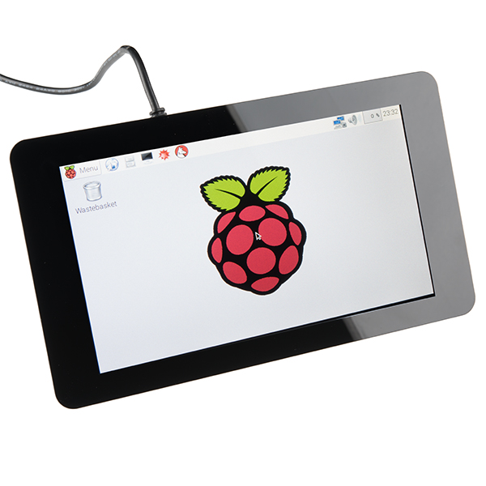
Interface (Monitor)
The interface we are using is a Raspberry Pi 7” LCD touchscreen display. The screen will be displaying our node-red UI and allow for the user to interact with it to send GPS coordinates for the vehicle to navigate to, as well as display environmental information.
Notes:
Discuss the reason for a touchscreen interface, why we chose this one specifically, etc.

Slide 12
UI
The UI will display sensor information such as temperature, oxygen, and many more. The UI will be created using Node-Red hosted on a Raspberry Pi which will receive sensor information and used in different visual components. The UI will also have GPS functionality and send that information to an ROS, for quick navigation.
The UI will also allow users to be able to put in coordinates to use for navigation.
Notes:
Discuss how node-red will be used for the UI, then explain the two screenshots

Slide 13
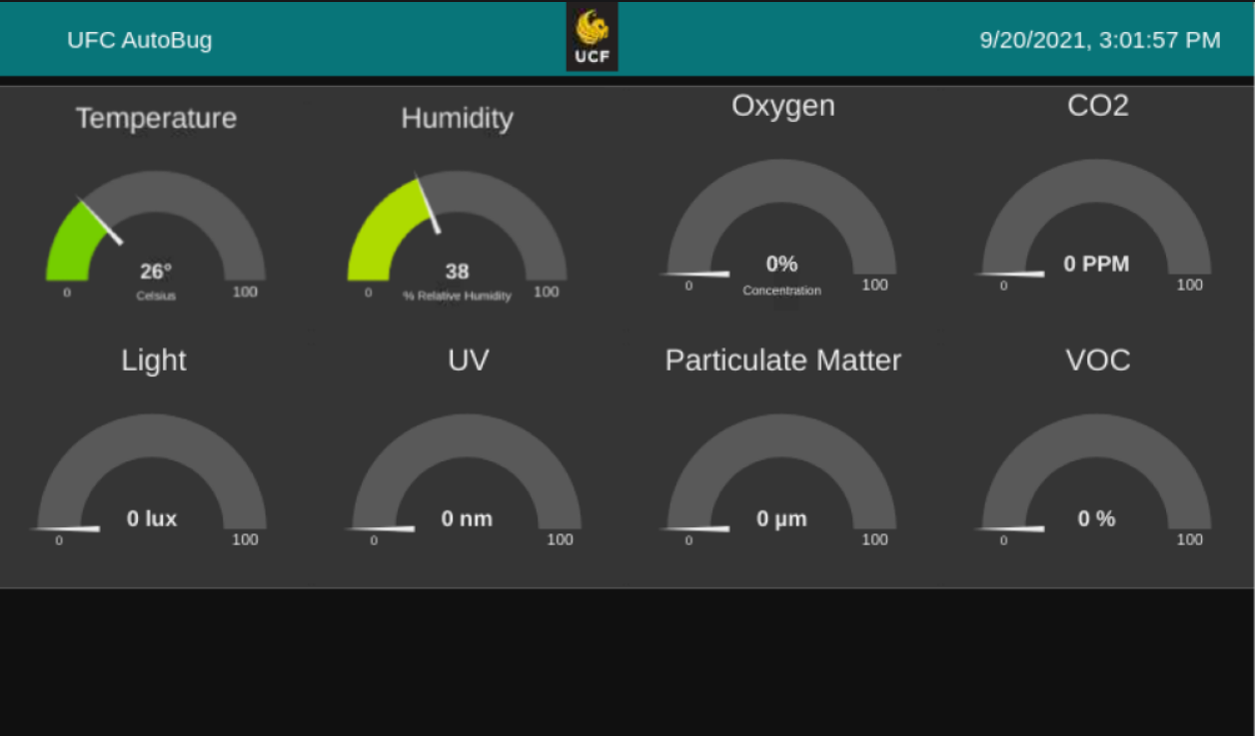

Slide 14
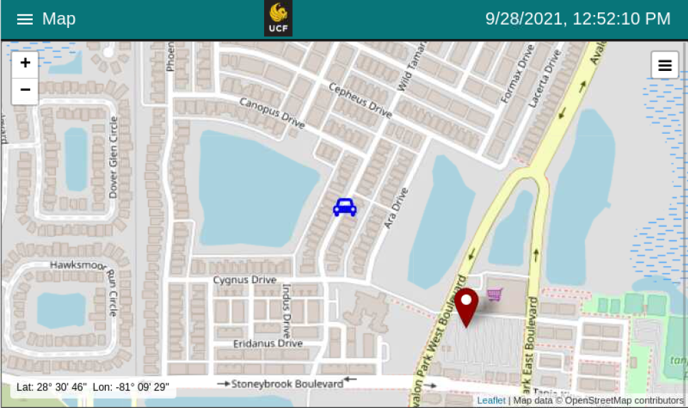
Notes:
How buggy navigation will work, GPS coordinates are received at around 2 ms to 6 ms.

Slide 15
NFC
For added security, we will be using an NFC sensor to lock the display. The screen will then unlock after interacting with a specific device.
So far, we are looking into creating a phone app in Android Studio or Swift which will send out the appropriate signal to unlock the screen.
Another option we have is to write credentials onto RFID cards which will unlock the screen.
Notes:
Discuss how NFC will work in relation to the vehicle (turn display on/off), and what we would use to activate the NFC (phone app or RFID cards).

Slide 16
The vehicle is controlled via ROS and an NVIDIA Jetson Nano
There are three modes of operation: GPS Waypoint Navigation, teleoperation, and manual driving.
GPS Navigation will be controlled by GPS data, ROS’s Navigation Stack, Robot_Localization, and RVIZ
Teleoperation will be controlled remotely with ROS and a remote transmitter.
Manual driving will be controlled with a driver in the vehicle.

Slide 17
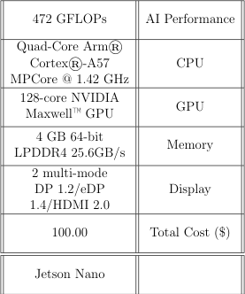
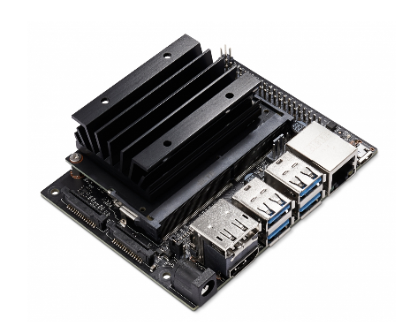
NVIDIA Jetson Nano
This is a low cost, powerful machine that will handle all of the vehicle’s control and object detection systems.

Slide 18
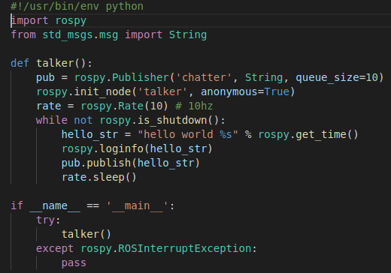
ROS & ROS nodes
ROS is a set of software libraries and tools that help you build robot applications. (ROS.org)
The basic nodes that will be used are:
Motor - Driving the vehicle
Encoders - Localization
Camera - Object Detection
Depth Cloud - Object Detection
Sonar - Object Detection
GPS - Odometry and localization
Compass - Odometry and localization
IMU and Accelerometer - Localization

Slide 19
ROS Node Graph - Overview

Slide 20
ROS Node Graph - Motors, Encoder GPS, Compass, IMU

Slide 21
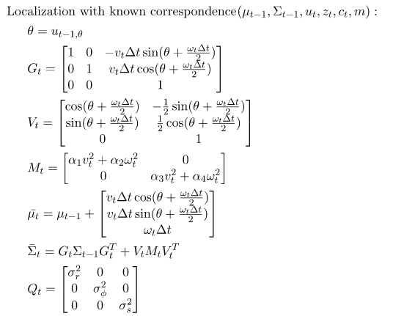
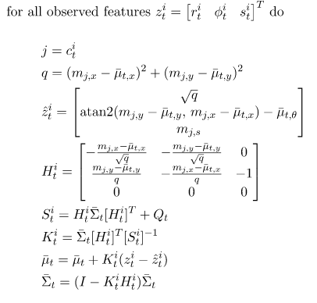
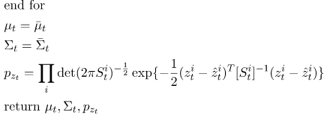
ROS Node Graph - EKF filter algorithm

Slide 22
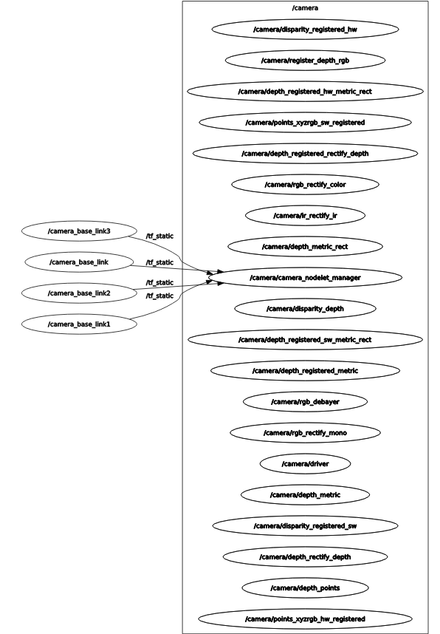
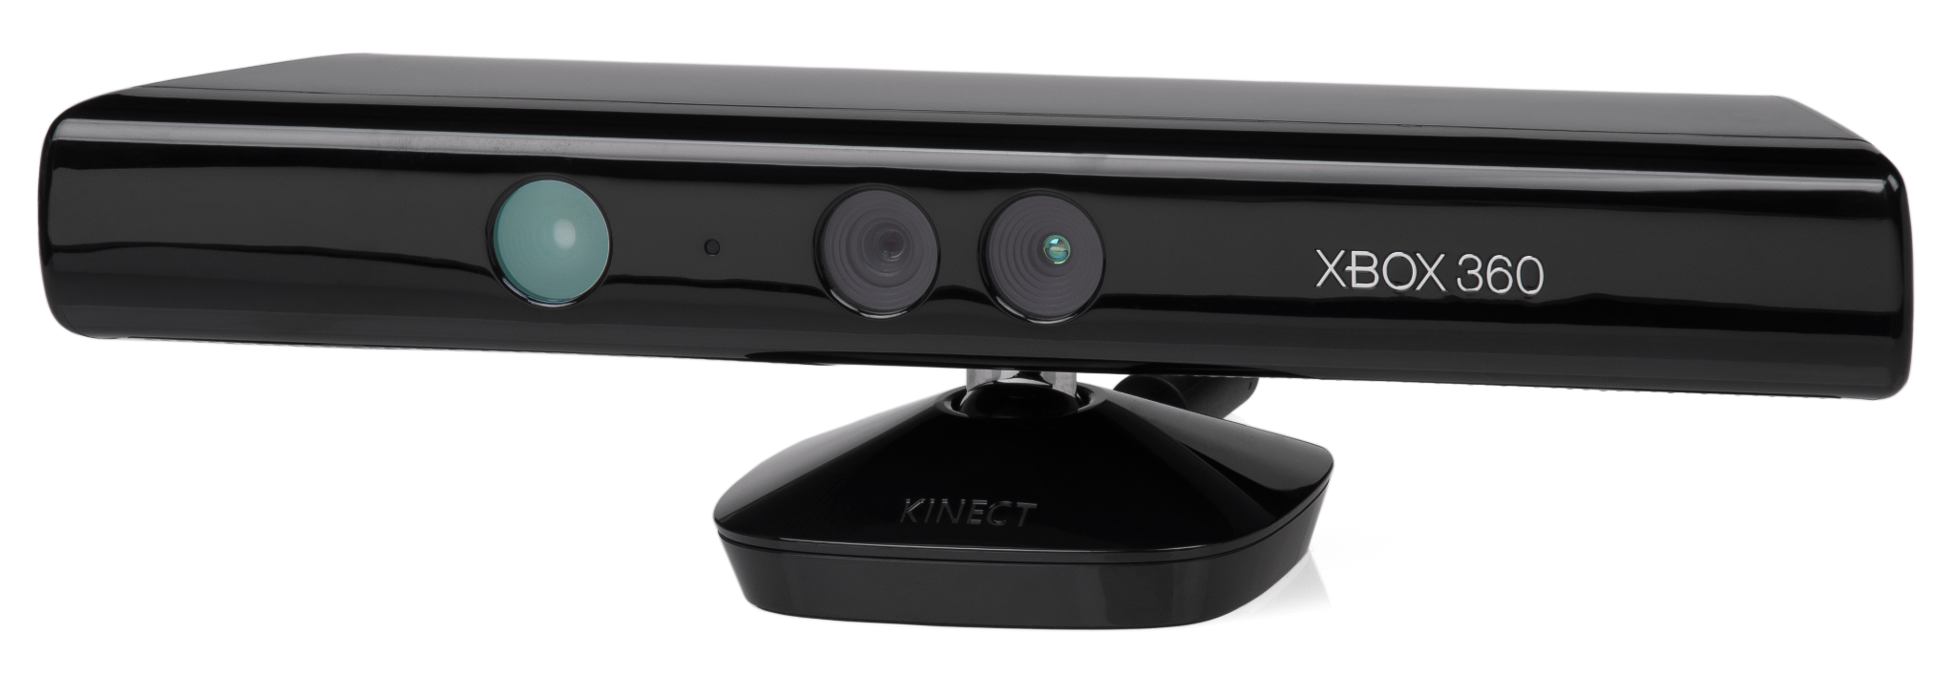
ROS Node Graph - Camera & Depth Cloud
A kinect will serve as the camera and depth sensor.
This will give the mobile robot “sight” to aid in localization and object detection

Slide 23
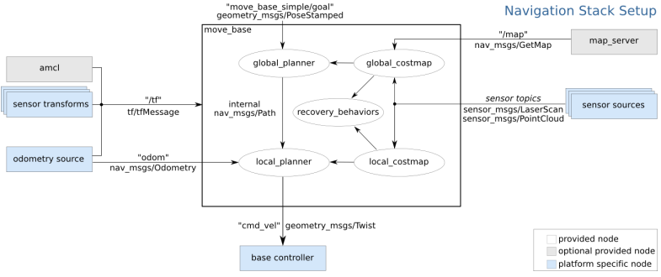
ROS Node Graph - Motors, Encoder GPS, Compass, IMU

Slide 24
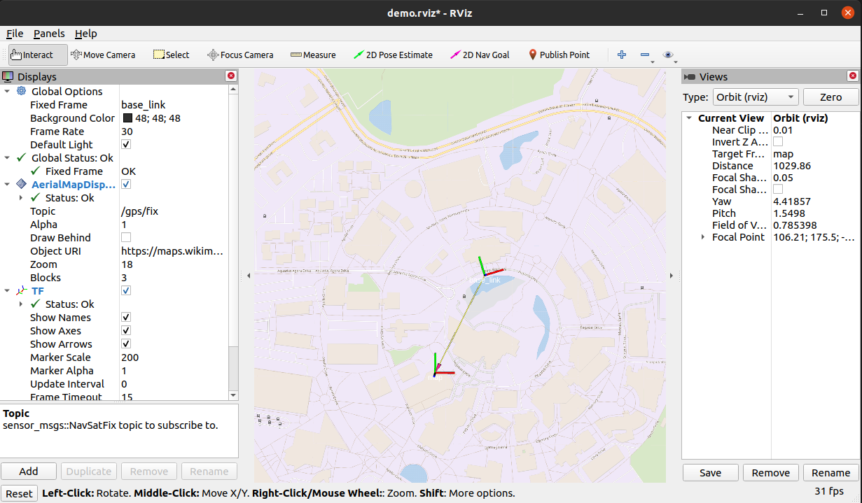
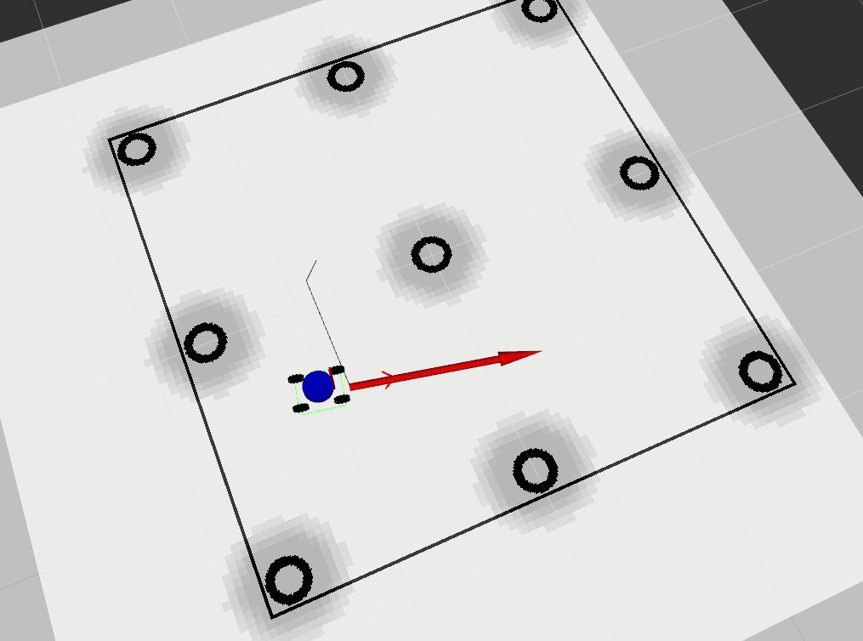
GPS Waypoint Navigation

Slide 25
Teleoperation and Manual Driving
Why have these options?
Unexpected failure
Difficult to navigate terrain
Power saving
Safety

Slide 26
Computer Vision & Deep Learning
For the object detection Tensorflow will be used.
This will allow me to customize the dataset, the model, and the output.
The main objects that will be detected are:
People
Terrain
Since the Jetson Nano will be running both ROS and tensorflow, the model will have to be simple.
This could impact the object detection, however if the model is too complex it could impact the performance of the AI controller.

Slide 27
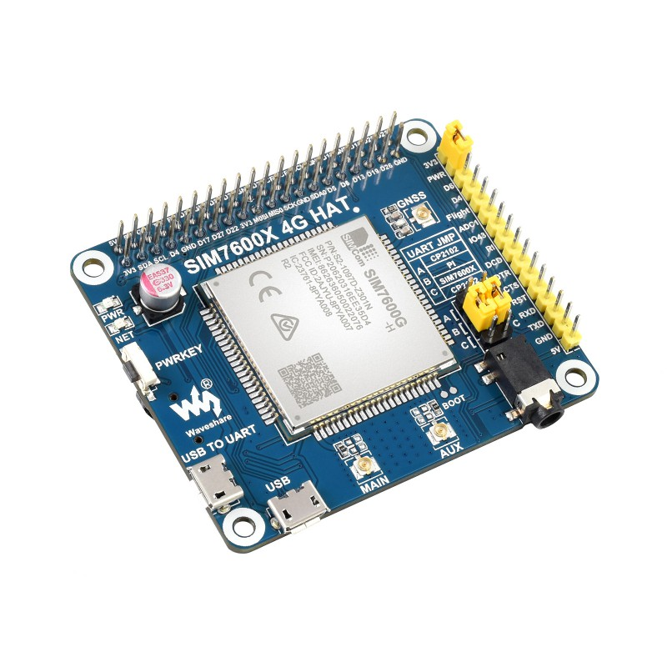
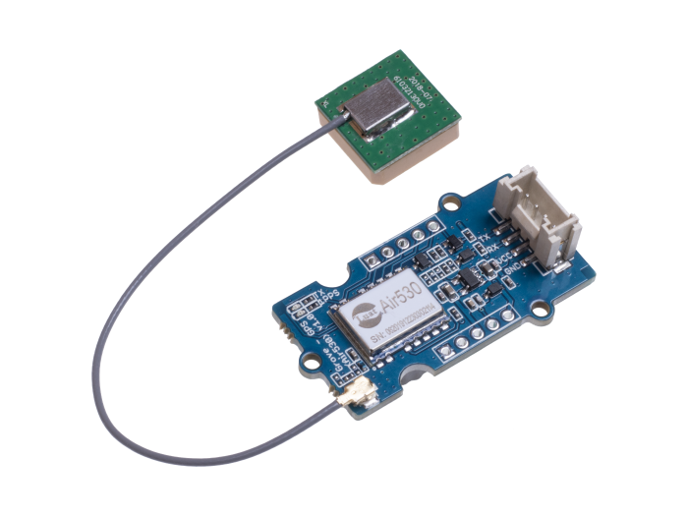
GPS/GSM
The vehicle will use a GPS module: the Grove Air-530 to map the current location of the vehicle on the UI.
We will also be utilizing a SIM7600 GSM Hat, which will allow us to connect to LTE networks which can extend the vehicle’s information to other platforms. However, this requires the use of a SIM card that needs a monthly membership.

Slide 28
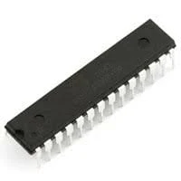
ATMega328P-U Microcontroller
AVR | Core Processor
8-Bit | Core Size
20 MHz | Speed
32KB | Program Memory Size
Flash | Program Memory Type
1K * 8 | EEPROM Size
2K * 8 | RAM Size
1.8V 5.5V | Voltage - Supply (Vcc/Vdd)
28 | Number of IO pins
$2.63 | Cost

Slide 29
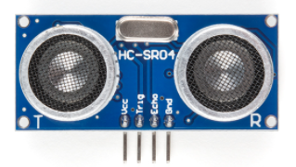
HC-SR04 Distance Sensor
Has a range between 0 and 400 centimeters
Our vehicle with have four of these, one on each corner of the car
Analog
Using these sensors, the driver will be notified via the touchscreen display that the vehicle is too close to an object
3.1V - 5V | Working Voltage
Analog | Communication
400cm | Max Range
0cm | Min Range
$7.95 | Cost

Slide 30
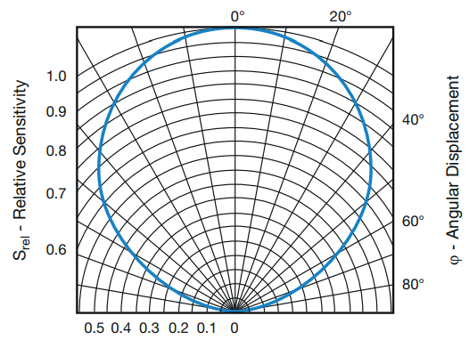
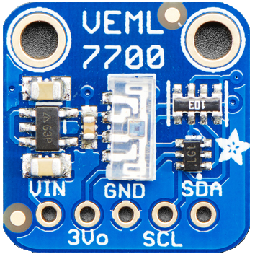
Adafruit VEML7700 Light Sensor
2.5V - 3.6V | Working Voltage
I2C | Communication
120klux | Max Range
0lux | Min Range
$4.95 | Cost
Calculates the lux of the surrounding area
Will be used to turn on vehicle headlights
Has I2C communication

Slide 31
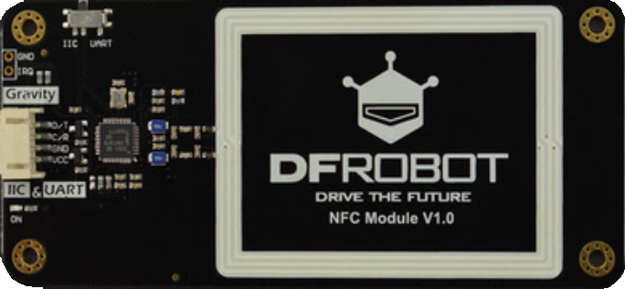
DFRobot NFC Sensor
Can communicate with either i2c or UART
Different protocol support
Reader/Writer
Card Emulation
Peer-to-Peer
Will unlock the touchscreen after communication with specific device

Slide 32
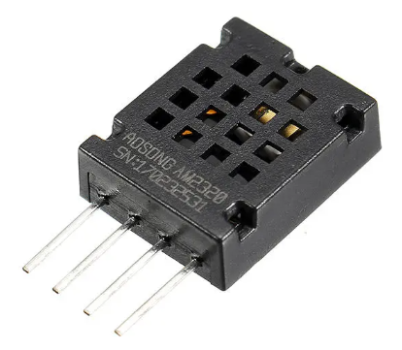
Adafruit AM2320 Temperature and Humidity Sensor
Measures temperature in between -40 to +80 degrees Celsius
Measures Humidity between 0 to 99.9 %RH (relative Humidity)
I2C Communication
3.1V - 5.5V | Working Voltage
I2C | Communication
+85० Celsius | Max Temp Range
-40० Celsius | Min Temp Range
99.9% | Max Humidity Range
0% | Min Humidity Range
$3.95 | Cost

Slide 33
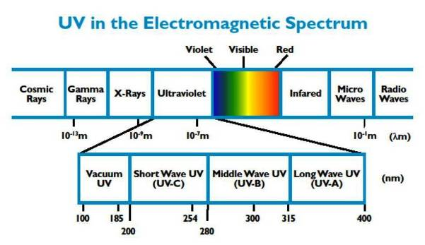
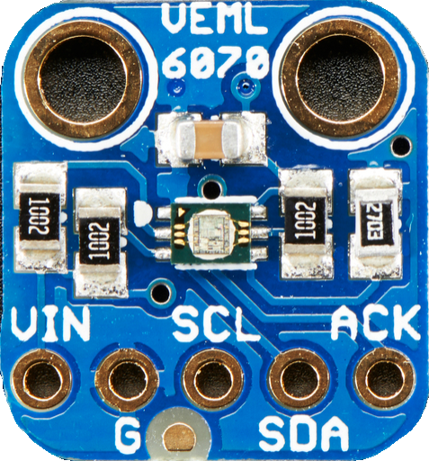
VEML 6070 UV Sensor
The is capable of detecting light in the UV spectrum. More specifically the UV-A spectrum
Does not produce a UV index value so calibration will be required.
Uses I2C for communication
2.7 V to 5.5 V | Working Voltage
I2C | Communication
410 nm | Max Range
320 nm | Min Range
$4.95 | Cost

Slide 34
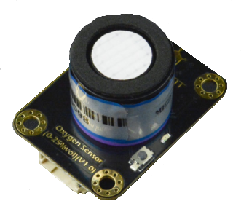
DFRobot SEN0322 Oxygen Sensor
Can measure the amount of oxygen in the air up to 25%
Unsafe Oxygen percentage is 19.5% and below
I2C communication
3.3V - 5.5V | Working Voltage
I2C | Communication
25% | Max Range
0% | Min Range
$53.90 | Cost
Notes:
Can measure the amount of oxygen in the air up to 25%, for reference, the amount of oxygen in the area is around 25%
Minimum safe level of oxygen for humans is 19.5%
------Explain What VOC’s are:
They are harmful gases that can emit from things such as paints and lacquers, paint strippers, cleaning supplies, pesticides, building materials and furnishings, office equipment such as copiers and printers, correction fluids and carbonless copy paper, graphics and craft materials including glues and adhesives, permanent markers, and photographic solutions.

Slide 35
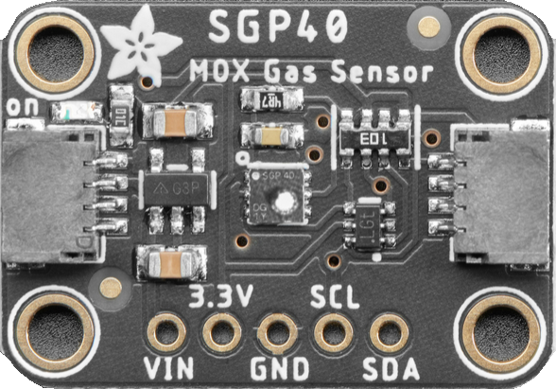
Adafruit SGP40 VOC Sensor:
Outputs a Volatile Organic Compounds index value
VOC’s can come from everyday things such as paint, cleaning supplies, office supplies, and more...
I2C communication
1.7V - 3.6V | Working Voltage
I2C | Communication
500 VOC index points | Max Range
0 VOC index points | Min Range
$4.95 | Cost
Notes:
Can measure the amount of oxygen in the air up to 25%, for reference, the amount of oxygen in the area is around 25%
Minimum safe level of oxygen for humans is 19.5%
------Explain What VOC’s are:
They are harmful gases that can emit from things such as paints and lacquers, paint strippers, cleaning supplies, pesticides, building materials and furnishings, office equipment such as copiers and printers, correction fluids and carbonless copy paper, graphics and craft materials including glues and adhesives, permanent markers, and photographic solutions.

Slide 36
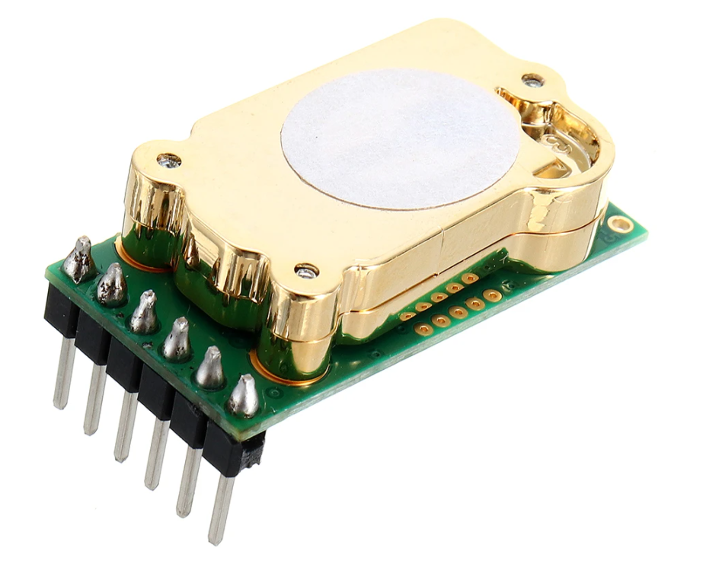
T6703-5k CO2 Sensor:
Measures the amount of CO2 in the area using nondispersive infrared technology
Can measure between 0ppm - 5000ppm (parts per million)
I2C or UART Communication
4.5V - 5.5V | Working Voltage
I2C or UART | Communication
5000ppm | Max Range
0ppm | Min Range
$37.99 | Cost

Slide 37
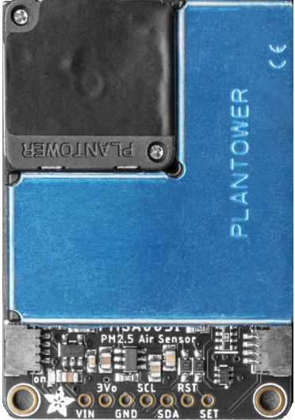
Adafruit PMSA003I Particulate Matter Sensor:
Uses laser scattering to detect particles in small air samples
Determines size of particle and places data in a bin representing size.
Outputs the number of particles suspended in the air sample
I2C communication
4.5V - 5.5V | Working Voltage
I2C | Communication
10um | Max Range
0.3um | Min Range
$44.95 | Cost

Slide 38
Motor Power System
A 12V 4.5Ah OEM battery is installed
Will be upgraded as more testing is done with a 10Ah SLA to increase runtime as well as balance weight
Can be charged in vehicle, or swapped for minimal downtime

Slide 39
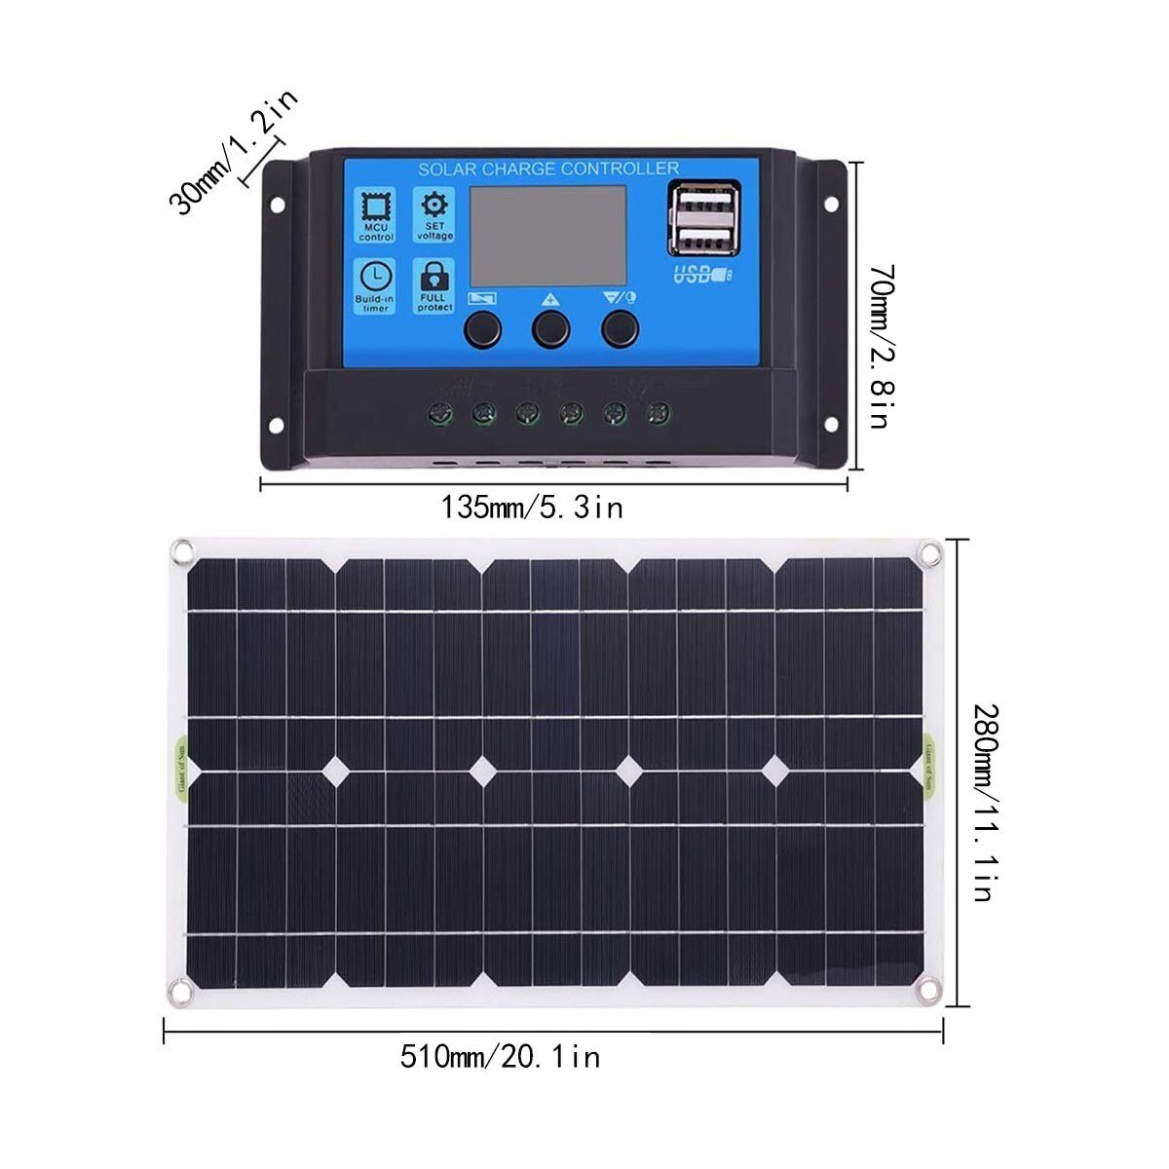
Charging System
100W (12V 8A) solar panel
Attached to vehicle 12V battery
Floating charger
12V DC barrel connector Rapid charger when not in use

Slide 40
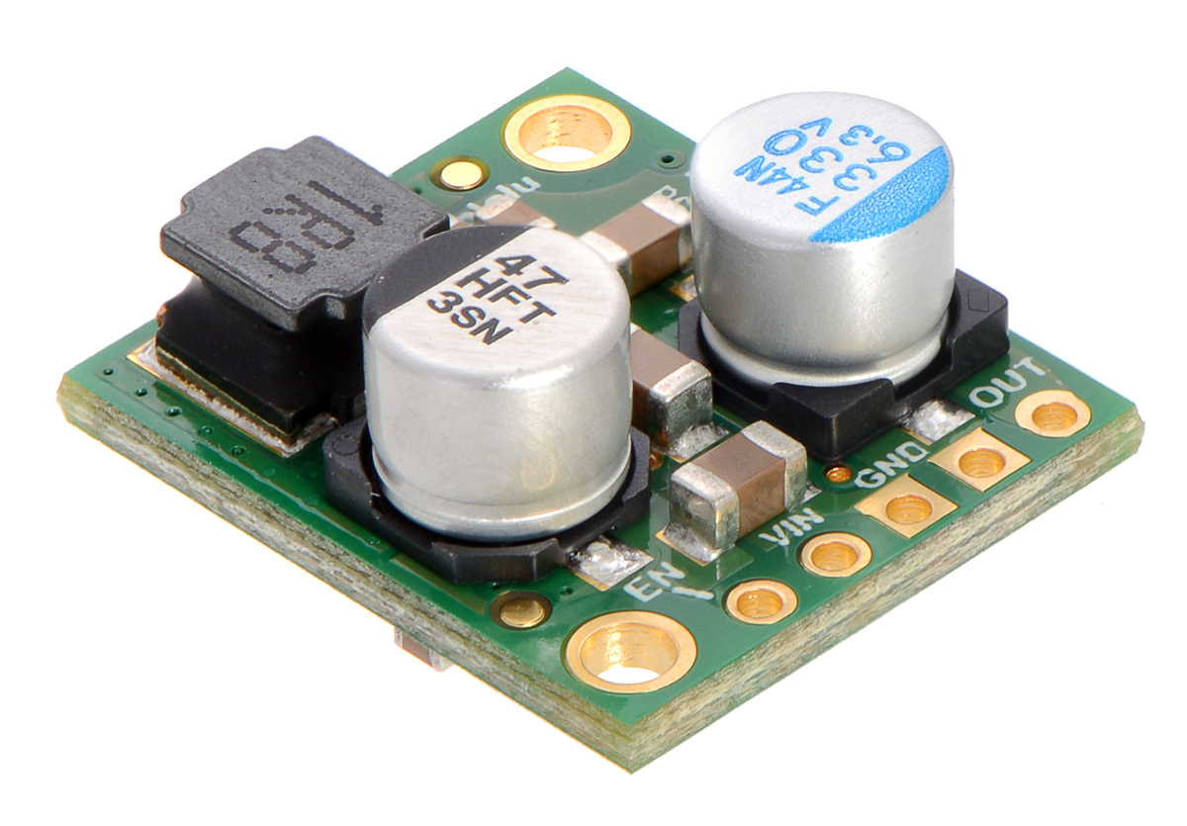
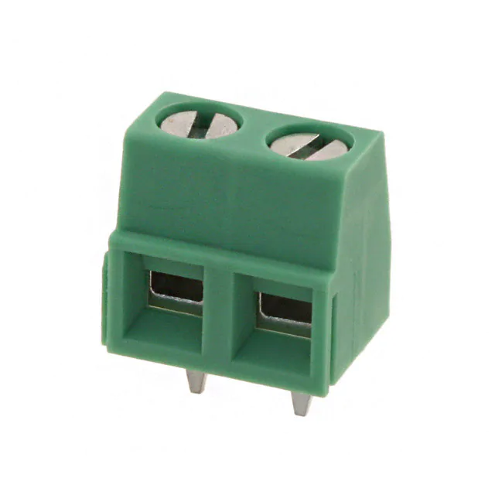
Computer Power System
Will use a separate 12V system with a common ground
Done to isolate noise/keep connectivity when swapping vehicle power source
12V-2A power tool battery transformed down to 5V
Step down voltage regulator (d24v50f5)
Connected to battery via screw terminals (14-30 AWG)
Reverse polarity protection

Slide 41
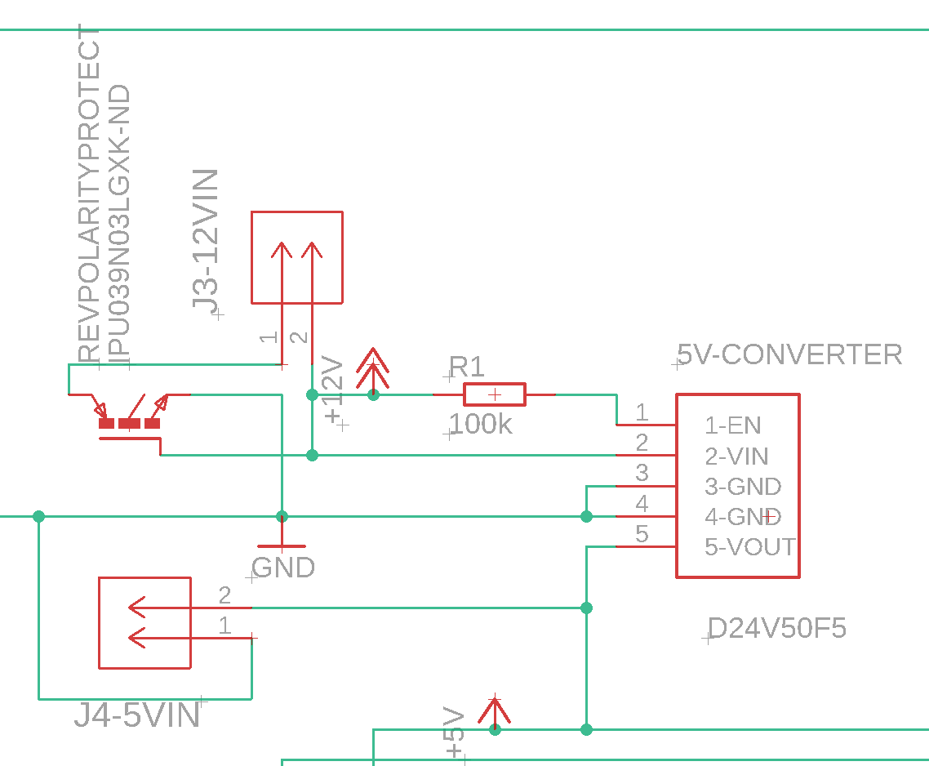
Power Input
12V/18V Input Screw Terminal
N-Mos Reverse Polarity Protection
5V Voltage Regulator
5V Test Point

Slide 42
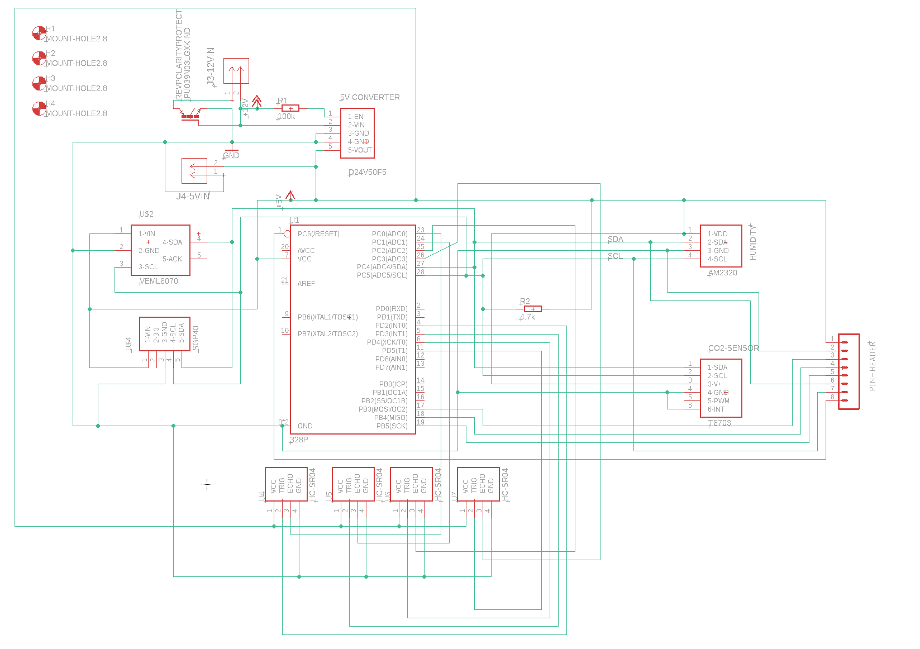
Design Schematic

Slide 43
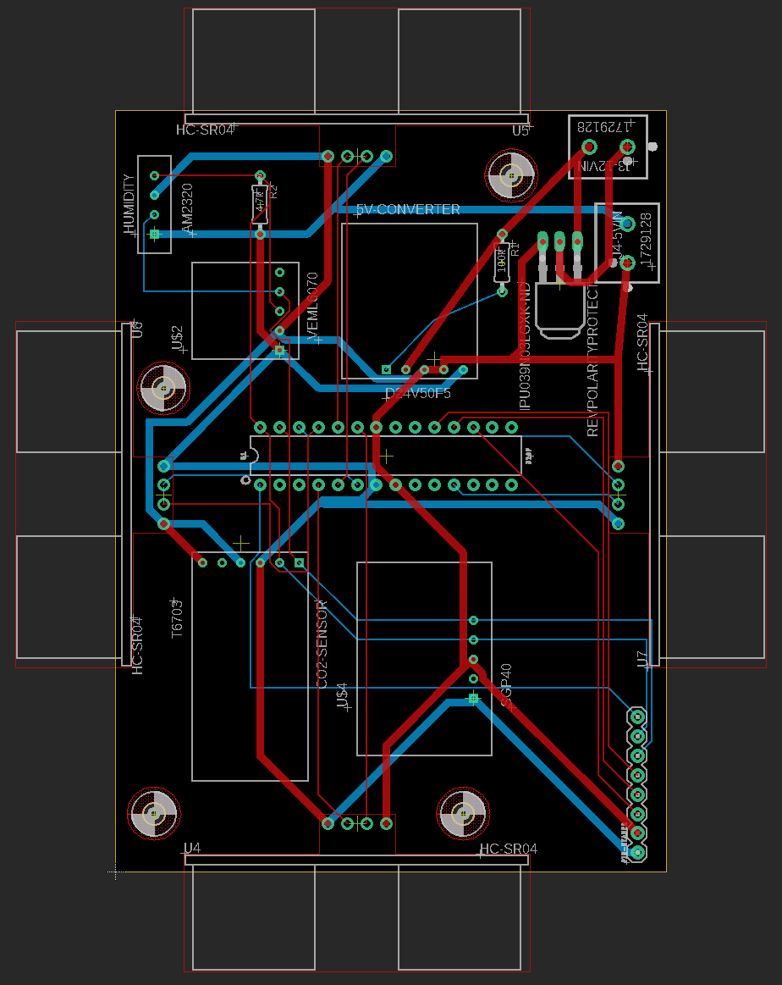
Board Design
2 layer board
2oz/ft copper
No ground plane or Vias
length/impedance matched I2C lines
2.8mm screw mounting holes for printed enclosure
Laid out for ease of testing and heat dissipation

Slide 44
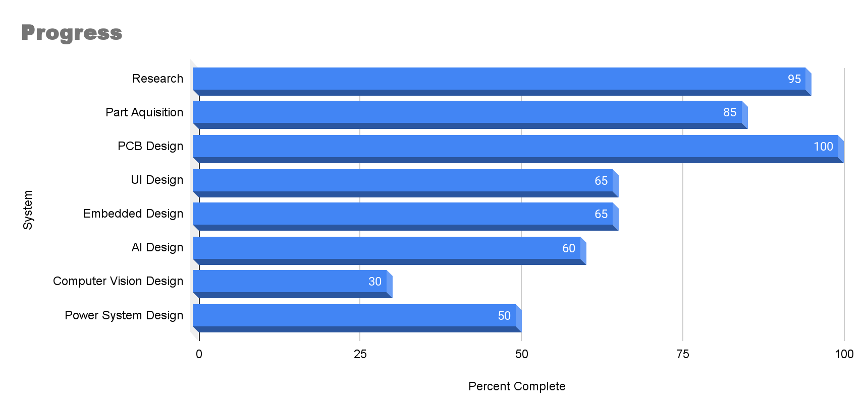
Progress

